Slide 1



DEPARTMENT OF COMPUTER ​
ENGINEERING AND APPLICATIONS​
Mini Project on Online Quiz System
Welcome to our presentation on the Mini Project of an Online Quiz System using HTML, CSS, and JavaScript. Join us as we explore the key aspects and features of this exciting project.
Suraj Verma
Dev Soni
DATE :- 01 December 2023

Slide 2


Introduction
In this section, we provide an overview of the online quiz system, explaining its significance and benefits in educational settings. We also discuss the increasing popularity of online learning platforms.

Slide 3
Objectives
Enhance Learning Experience
Efficient Evaluation
Implement features that make learning engaging and interactive for students.
Create an automated system for evaluating student performance and giving instant feedback.
User-Friendly Interface
Flexible Question Types
Design an intuitive interface that ensures ease of navigation for both students and instructors.
Support diverse types of questions, including multiple-choice, true/false, and fill in the blanks.

Slide 4
Problem Statement
1
Limited Accessibility
2
Evaluation Bias
3
Data Security
Tackle the issue of subjective evaluation by implementing standardized automated grading.
Ensure the system protects sensitive student data and prevents unauthorized access.
Address the challenge of providing equal access to quizzes for students with different backgrounds and abilities.

Slide 5
Literature Review
The Rise of Online Education
Effectiveness of Online Assessments
Best Practices for Quiz Design
Explore the research and findings on the impact of online learning in educational institutions worldwide.
Discuss recommendations from experts on creating effective and engaging online quizzes.
Examine studies that highlight the benefits and challenges of using online quizzes as an assessment tool.

Slide 6
Methodology
1
Requirement Analysis
Gather user requirements and define the scope of the online quiz system project.
2
Design and Planning
Create wireframes, design the user interface, and plan the development process.
3
Development and Testing
Implement the system using HTML, CSS, and JavaScript, and perform rigorous testing for functionality and usability.
4
Deployment and Maintenance
Deploy the online quiz system and provide ongoing maintenance and support to ensure smooth operation.

Slide 7
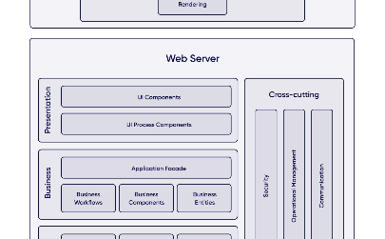
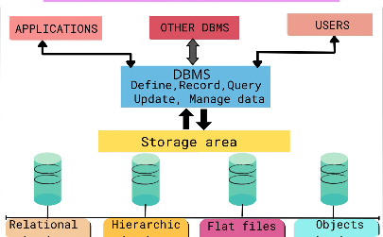

System Architecture
Client-Server Model
Database Integration
Secure Communication
Illustrate the architecture of the online quiz system, showing the interaction between users' browsers and the server.
Explain how the system utilizes a database management system to store and retrieve quiz-related data.
Highlight the importance of secure connections and encryption protocols to protect users' data during transmission.

Slide 8
Implementation
User Registration
Quiz Creation
Allow students and instructors to create accounts, enabling personalized access to the online quiz system.
Empower instructors to create quizzes, set time limits, and customize question formats.
Quiz Taking
Result Analysis
Enable students to take quizzes online, with real-time feedback and auto-grading functionality.
Provide comprehensive analytics on individual and class performance, aiding instructors in identifying areas for improvement.

Slide 9
Features
1
Randomized Questions
2
Online Timer
Generate random question sets to prevent cheating and enhance fairness.
Include a countdown timer to ensure time-bound quizzes and evaluate time management skills.
3
Real-Time Feedback
4
Leaderboard
Provide immediate feedback to students, helping them learn from their mistakes right away.
Implement a leaderboard to foster healthy competition and recognize the top performers in quizzes.

Slide 10

Results
Present the positive outcomes observed after deploying the online quiz system and share data on improved student engagement, performance, and feedback from users.

Slide 11

Challenges Faced
1
User Adaptability
2
Technical Limitations
3
Scalability
Address the initial resistance faced by some students and instructors in transitioning to online quizzes.
Describe the strategies implemented to ensure the system can handle a large number of users simultaneously.
Discuss the challenges encountered during the development process and how they were overcome.

Slide 12
Future Work
Outline potential enhancements to the online quiz system, such as integration with learning management systems, mobile app development, and adaptive learning algorithms.

Slide 13

Conclusion
In this final section, we summarize the key takeaways from our presentation and emphasize the significance of adopting the online quiz system in modern educational environments.

Slide 14

Acknowledgments
Express gratitude to the individuals and institutions whose support and contributions made the development of the online quiz system possible.

Slide 15

Q&A
Open the floor for questions and answers, allowing the audience to seek clarification or share their thoughts on the presented information.

Slide 16

Thank You
Express appreciation to the audience for their time and attention, reiterating the importance of implementing innovative solutions in the field of education.

